Slide 1
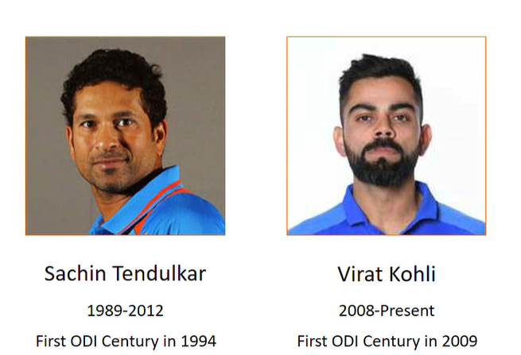
SACHIN VS KOHLI
-GOD VS KING
AN ANALYTICAL DEBATE

Slide 2
CONCLUSION:1/6
RUNS PER INNINGS:
SACHIN: 1.94
VIRAT: 2.02

Slide 3
CONCLUSION:2/6
STRIKE RATE:
SACHIN:1.21
VIRAT:1.11

Slide 4
CONCLUSION:3/6
MATCHES FOR A 100:
SACHIN:0.15
VIRAT:0.18

Slide 5
CONCLUSION:4/6
MATCHES FOR A 50:
SACHIN:0.57
VIRAT:0.55

Slide 6
CONCLUSION:5/6
TEAM CONTRIBUTION:
SACHIN:16.95%
VIRAT:16.18%

Slide 7
CONCLUSION:6/6
THIS IS DONE BY COMPARING NORMALIZED VALUES FOR BOTH
PARAMETER | SACHIN | KOHLI | WINNER
RUNS PER INNINGS | 1.94 | 2.02 | KOHLI
STRIKE RATE | 1.21 | 1.11 | SACHIN
100’S PER MATCH | 0.15 | 0.18 | KOHLI
50’S PER MATCH | 0.57 | 0.55 | SACHIN
TEAM CONTRIBUTION | 16.95% | 16.18% | SACHIN

